Slide 1
Capstone Project
Noha Hamdy

Slide 2
agenda
Introduction​
Objective
​Demonstration
Technical aspects
​Summary​

Slide 3
introduction
I have learned a lot during my fruitful journey in ALX and In this project, I applied the software development principles I learned in the ALX program to design and implement a new feature for a popular web application.be a good start for me in the world of software engineering

Slide 4
objective
My Personal Portfolio Website gives the viewer Easy to navigation through my projects.
My contact info are readily available for any interested clients or visitors.

Slide 5
Your personal portfolio website is more than just a collection of your work. It's a reflection of your brand and who you are as a professional
“
”
Mark Brown, Web Designer

Slide 6
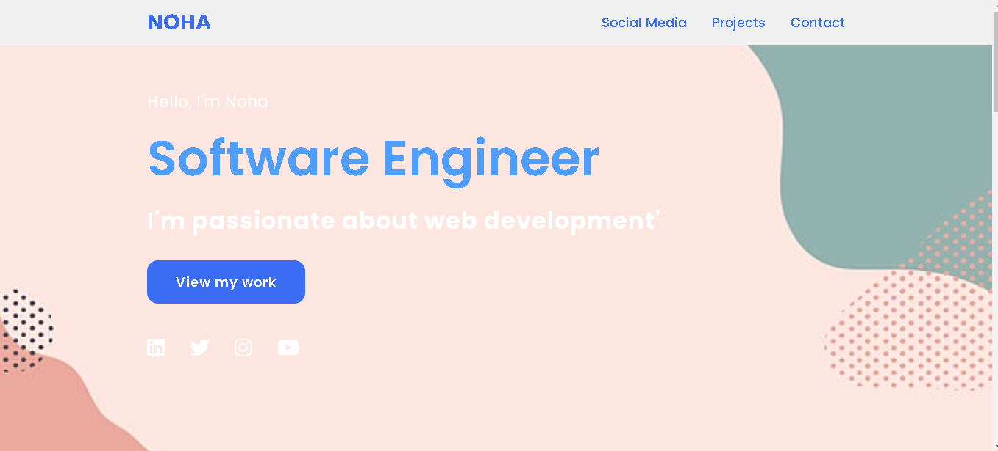
Demonstration

Slide 7
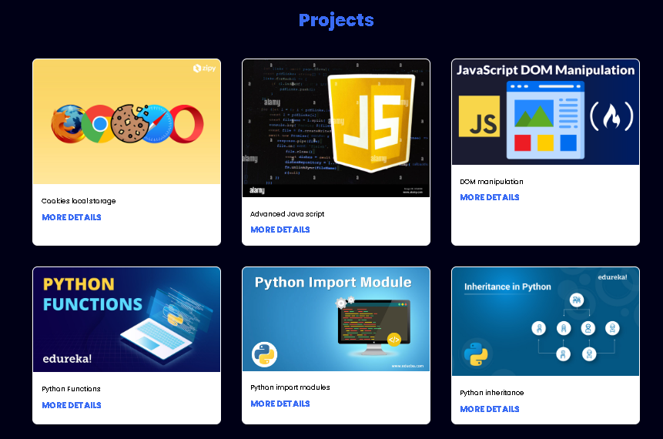

Slide 8
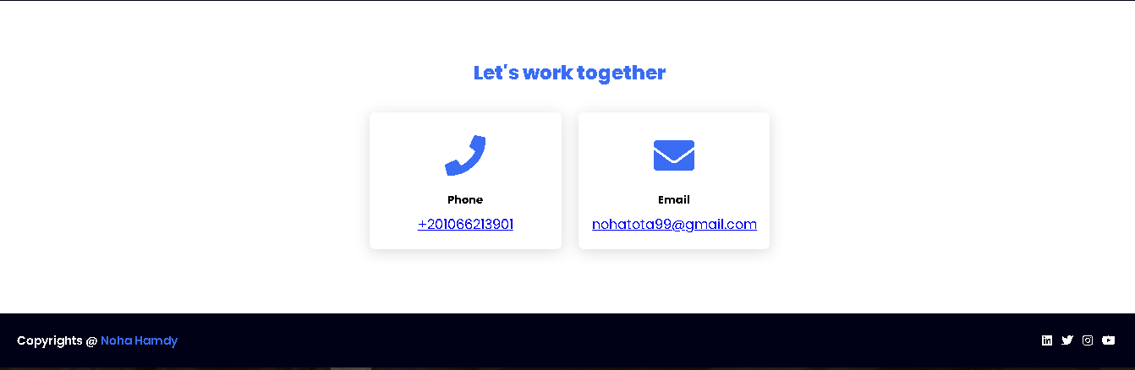

Slide 9
Technical aspects
HTML
CSS
Pytnon

Slide 10
summary
I am excited to launch my first professional website, which is just the beginning of my journey as a software engineer. I hope to use this website to showcase my skills and experience to potential employers and to connect with other software engineers. I am passionate about building innovative and impactful web applications, and I look forward to using my skills to make a positive impact on the world.

Slide 11
Thank you
Noha Hamdy​
nohatota99@gmail.com

